Slide 1



A brief guide to sequencing
Dr Gavin Band

Slide 2
Introductions
Epidemiology
Bioinformatics
Genetics
Basic principles of measuring disease in populations
Basic genotype data summaries and analyses
population genetics
Public databases and resources for genetics
GWAS QC
Principal components analyses
GWAS association analyses
whole genome sequencing and fine-mapping
GWAS results and interpretation
meta-analysis and power of genetic studies

Slide 3
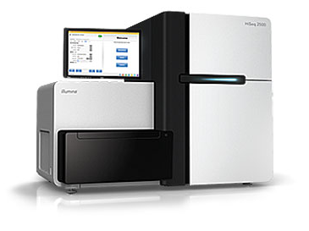
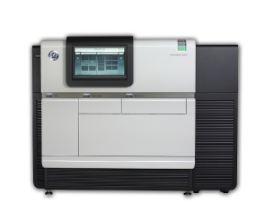
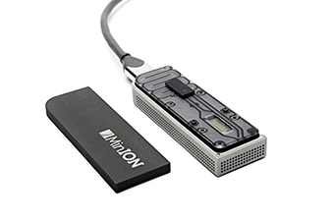
A brief guide to sequencing

Slide 4
Why sequence?
A key motivation for sequencing is to discover and type more genetic variation, either within a region or across the whole genome.
In particular, sequencing can be used to fine-map signals of associations by identifying putatively functional mutations that may not have been typed in the original data.

Slide 5
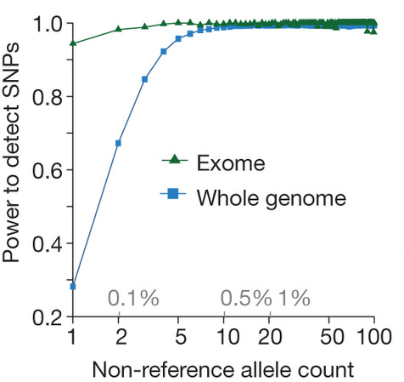
Why sequence?
E.g. sequencing the whole genome:
E.g. 99% of SNPs with at least 1% frequency detected
REDACTED
REDACTED
REDACTED

Slide 6
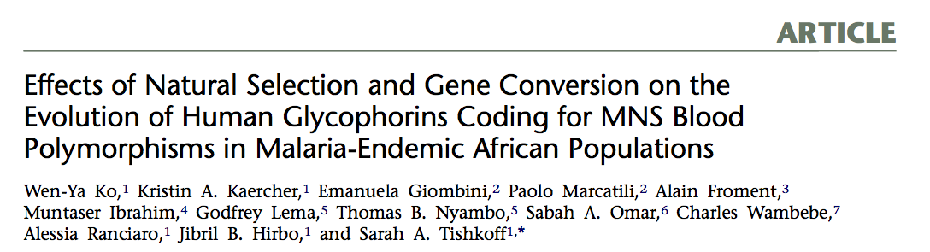
Why sequence?
E.g. sequencing within a region:
Sequencing of three genes
In 282 Africans

Slide 7
A comparison of technologies
 | Genotyping array
What can you type? | Previously identified variants
What do you get out? | Chip intensities per variant per sample.
How much data? | e.g. 50Mb per sample
How do you process it? | Call genotypes from intensity files.
How much does it cost? | $

Slide 8
A comparison of technologies
 | Genotyping array | ‘Next-generation’* sequencing
What can you type? | Previously identified variants | The whole genome! (Except inaccessible bits)
What do you get out? | Chip intensities per variant per sample. | Short (e.g. 100bp), accurate reads
How much data? | e.g. 50Mb per sample | e.g. 40Gb per sample @ 12x coverage
How do you process it? | Call genotypes from intensity files | Map to a reference sequence to call variation.
How much does it cost? | $ | $$
* This is typical current-generation sequencing.

Slide 9
A comparison of technologies
 | Genotyping array | ‘Next-generation’* sequencing | Single-molecule sequencing
What can you type? | Previously identified variants | The whole genome! (Except inaccessible bits) | The whole genome! (Except really inaccessible bits)
What do you get out? | Chip intensities per variant per sample. | Short (e.g. 100bp), accurate reads | Long (e.g. 4kb), less accurate reads.
How much data? | e.g. 50Mb per sample | e.g. 40Gb per sample @ 12x coverage | Similar to short-read data
How do you process it? | Call genotypes from intensity files | Map to a reference sequence to call variation. | Custom mapping/assembly pipelines
How much does it cost? | $ | $$ | $$$$$
* This is really the current generation sequencing.

Slide 10
A comparison of technologies
 | Genotyping array | ‘Next-generation’* sequencing | Single-molecule sequencing
What can you type? | Previously identified variants | The whole genome! (Except inaccessible bits) | The whole genome! (Except really inaccessible bits)
What do you get out? | Chip intensities per variant per sample. | Short (e.g. 100bp), accurate reads | Long (e.g. 4kb), less accurate reads.
How much data? | e.g. 50Mb per sample | e.g. 40Gb per sample @ 12x coverage | Similar to short-read data
How do you process it? | Call genotypes from intensity files | Map to a reference sequence to call variation. | Custom mapping/assembly pipelines
How much does it cost? | $ | $$ | $$$$$
* This is really the current generation sequencing.

Slide 11
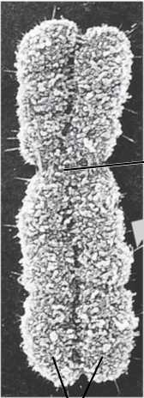
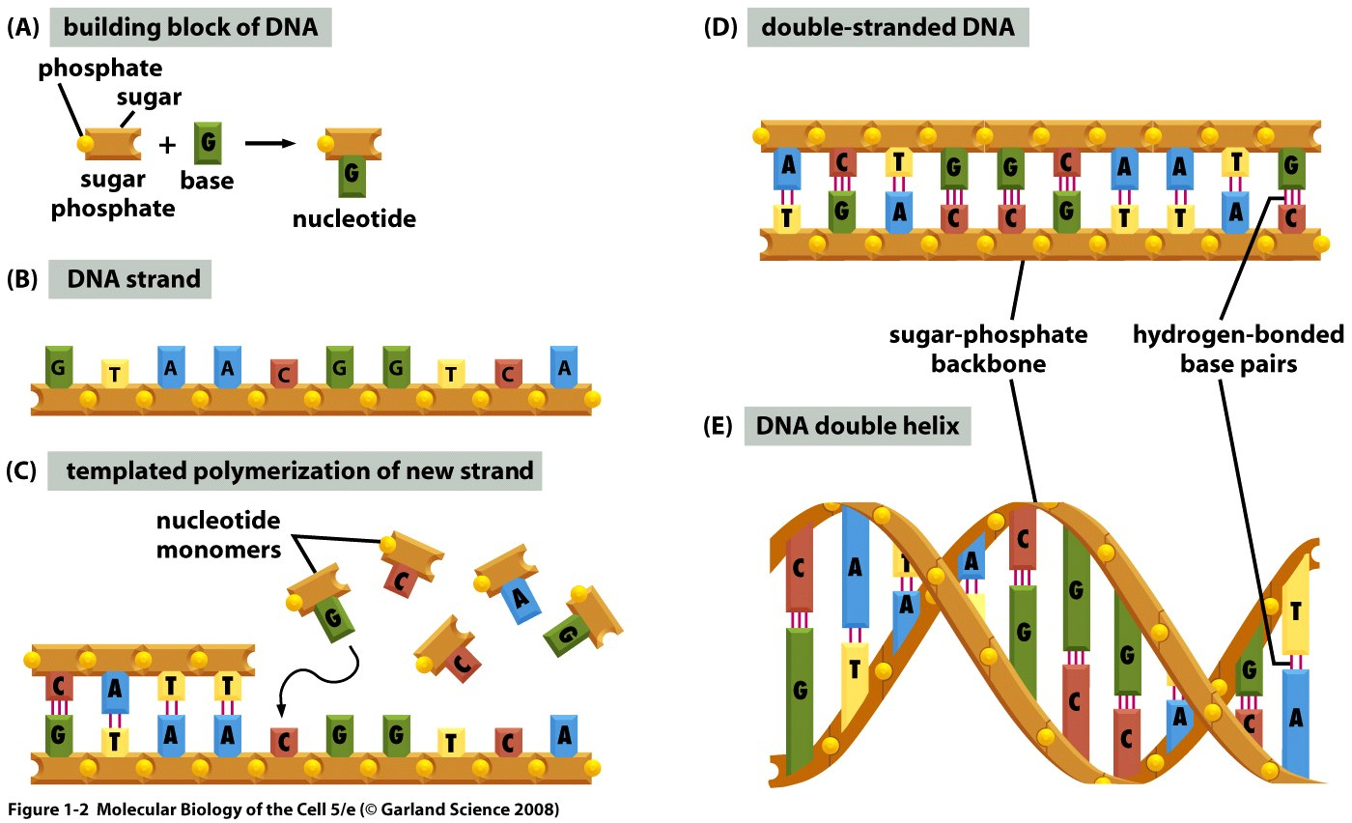
Typical sequencing pipeline
1. Whole DNA goes in…
2. DNA gets sheared into
short fragments
(typically 400-1000bp)
3. DNA gets amplified and adapted
4. Fragments are sequenced…
5. Reads come out.

Slide 12
Anatomy of a read
Direction of read
Direction of read
“Insert size”
“Paired ends”

Slide 13
Anatomy of a read
Direction of read
Direction of read
…GGTGTCTGTATTGAATTGCCGCTAGCTAGACTAGCTAC
AGGCAGGCTTTAGGCTAGGCAGTCCCTAGGCCGCCGCTTGCATATGC…

Slide 14
Anatomy of a read
Direction of read
Direction of read
High-quality bases
…GGTGTCTGTATTGAATTGCCGCTAGCTAGACTAGCTAC
AGGCAGGCTTTAGGCTAGGCAGTCCCTAGGCCGCCGCTTGCATATGC…
Lower-quality bases

Slide 15
Typical sequencing pipeline
1. Whole DNA goes in…
2. DNA gets sheared into
short fragments
(typically 400-1000bp)
3. DNA gets amplified and adapted
4. Fragments are sequenced…
5. Reads come out.

Slide 16
How to assemble it?
?

Slide 17
Aligning back to the reference sequence
Reference sequence
...ATAGATAGACCATACTGCATCGCAAGCAGCTACGCTAGCGTTAGGCATGG...
...ATAGATAGACCAGA
GGC..
ATAGATAGACCATACTCCAT
GAAAGACCATACTCCATCGCTAGCAGCACGCTAGAG
GAAAGACCATACTCCATCGCTAGCAGCTACGCTAGAG
TCCATCGCAAGCAGCTACGCTAGAGTTAGGCA
ATCGCAAGCAGCTAGGCTAGAGTTAGGCATCCGC..
Sequencing reads
Does this map here?
ACCGCAGGCAGGTTGGCACCAGTTTTAGAAATCCGC

Slide 18
Aligning back to the reference sequence
Reference sequence
...ATAGATAGACCATACTGCATCGCAAGCAGCTACGCTAGCGTTAGGCATGG...
...ATAGATAGACCAGA
GGC..
ATAGATAGACCATACTCCAT
GAAAGACCATACTCCATCGCTAGCAGC-ACGCTAGAG
GAAAGACCATACTCCATCGCTAGCAGCTACGCTAGAG
TCCATCGCAAGCAGCTACGCTAGAGTTAGGCA
ATCGCAAGCAGCTAGGCTAGAGTTAGGCATCCGC..
Sequencing reads
Does this map here?
ACCGCAGGCAGGTTGGCACCAGTTTTAGAAATCCGC

Slide 19
Aligning back to the reference sequence
...ATAGATAGACCATACTGCATCGCAAGCAGCTACGCTAGCGTTAGGCATGG...
...ATAGATAGACCAGA
GGC..
ATAGATAGACCATACTCCAT
GAAAGACCATACTCCATCGCTAGCAGC ACGCTAGAG
GAAAGACCATACTCCATCGCTAGCAGCTACGCTAGAG
TCCATCGCAAGCAGCTACGCTAGAGTTAGGCA
ATCGCAAGCAGCTAGGCTAGAGTTAGGCATCCGC..
Read depth (coverage) = 4
Read depth = 1
Read depth = 3

Slide 20
Mapping back to the reference sequence
...ATAGATAGACCATACTGCATCGCAAGCAGCTACGCTAGCGTTAGGCATGG...
...ATAGATAGACCAGA
GGC..
ATAGATAGACCATACTCCAT
GAAAGACCATACTCCATCGCTAGCAGC ACGCTAGAG
GAAAGACCATACTCCATCGCTAGCAGCTACGCTAGAG
TCCATCGCAAGCAGCTACGCTAGAGTTAGGCA
ATCGCAAGCAGCTAGGCTAGAGTTAGGCATCCGC..
Variation:
T/A
T/G
A/T
indel
C/A
G/C
?

Slide 21
Aligning back to the reference sequence
...ATAGATAGACCATACTGCATCGCAAGCAGCTACGCTAGCGTTAGGCATGG...
...ATAGATAGACCAGA
GGC..
ATAGATAGACCATACTCCAT
GAAAGACCATACTCCATCGCTAGCAGC ACGCTAGAG
GAAAGACCATACTCCATCGCTAGCAGCTACGCTAGAG
TCCATCGCAAGCAGCTACGCTAGAGTTAGGCA
ATCGCAAGCAGCTAGGCTAGAGTTAGGCATCCGC..
Variation:
T/A
T/G
A/T
indel
C/A
G/C
Filtered variation:
T/A
A/T
C/A

Slide 22
Typical calling pipeline for discovering and/or typing variation in multiple samples
Align reads
to a reference sequence
into BAM file
Call genotypes
At bases where there’s some variation in the data.
into VCF or BCF file
Filter variants
E.g. by read depth, mapping quality, potential biases between ref and non-ref reads…
Into VCF or BCF file
Analyse
Into high-profile journal

Slide 23
Typical calling pipeline for discovering and/or typing variation in multiple samples
Align reads
to a reference sequence
into BAM file
Call genotypes
At bases where there’s some variation in the data.
into VCF or BCF file
Filter variants
E.g. by read depth, mapping quality, potential biases between ref and non-ref reads…
into VCF or BCF file
This is often the tricky part
Analyse
into high-profile journal

Slide 24
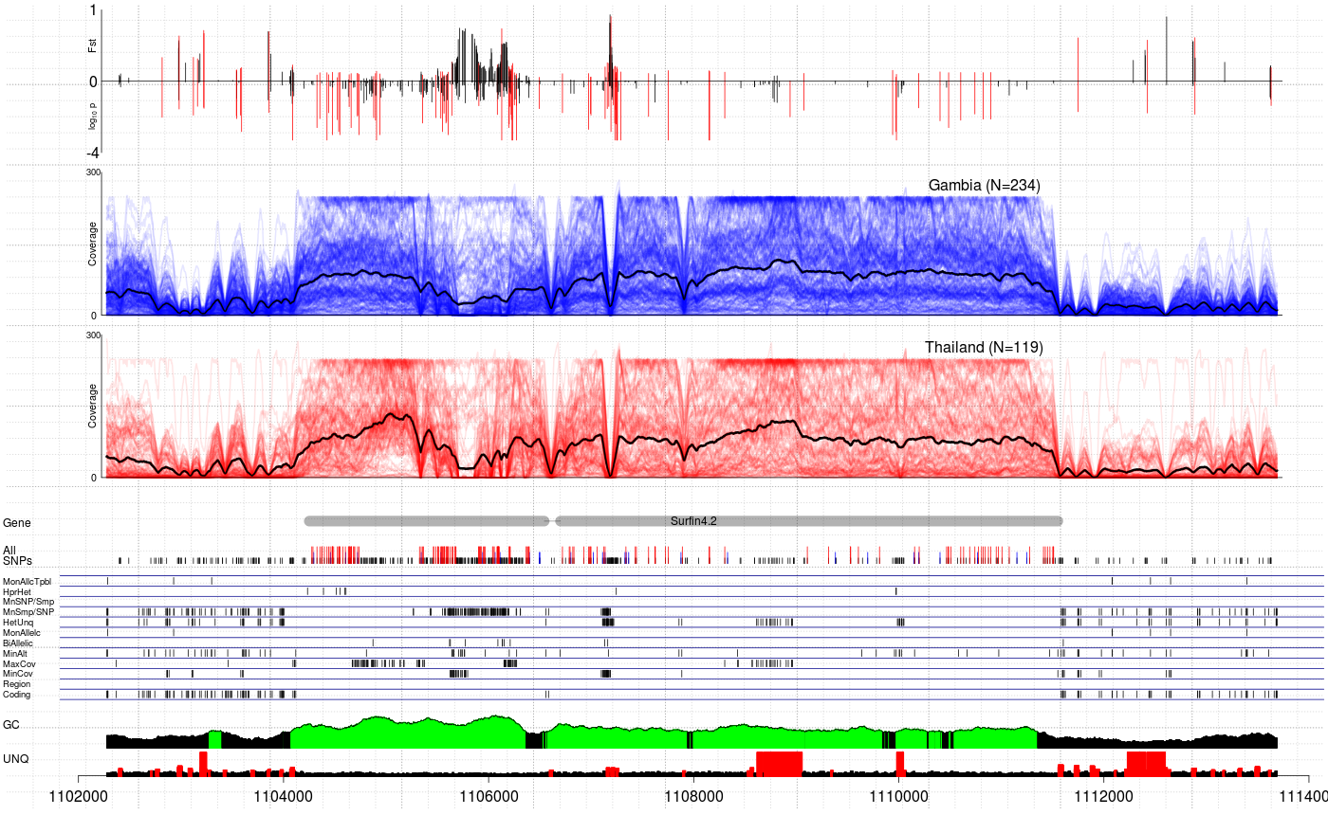
(Image provided courtesy of Jason Wendler based on MalariaGEN data)

Slide 25
What can possibly go wrong?

Slide 26
What can possibly go wrong?
The human genome is complex.
Short reads will not align well here

Slide 27
What can possibly go wrong?
CRG Align 100 track on UCSC Genome Browser

Slide 28

But I don’t have any sequencing data!
Luckily lots of data is publically available - in particular the 1000 Genomes project data can be downloaded:
http://www.1000genomes.org/data
ftp://ftp.1000genomes.ebi.ac.uk/vol1/ftp/
ftp://ftp-trace.ncbi.nih.gov/1000genomes/ftp/

Slide 29
File format glossary
Format name | What it contains | Where it comes from
FASTA/FASTQ | Sequences reads and quality scores. Also full genome and regional assemblies. | Sequencing. Also genome assembly.
BAM files (or SAM files) | Sequence reads mapped to a reference sequence. | Alignment algorithm – e.g. BWA.
VCF, BCF | Genotypes called from BAM files at polymorphic locations. | Calling algorithm – e.g. samtools mpileup + bcftools.
.fai, .bai, … | Index files, used to quickly access FASTA, BAM, or other files. | Indexing software – e.g. samtools index

Slide 30
Plan for the practical
Inspect some mapped read data in the FUT2 gene for a single individual using samtools
Call variation in across a set of individuals using samtools and bcftools
Use this data to understand LD between these variants and our GWAS ‘hit’.

