Slide 1
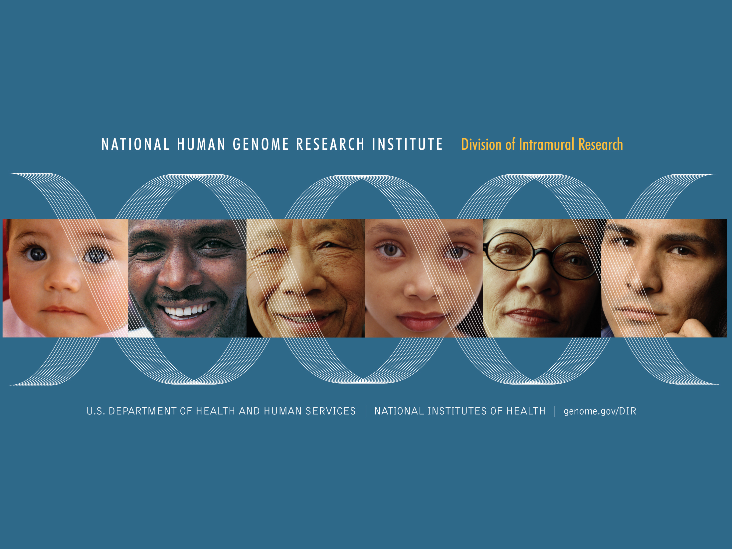

Slide 2
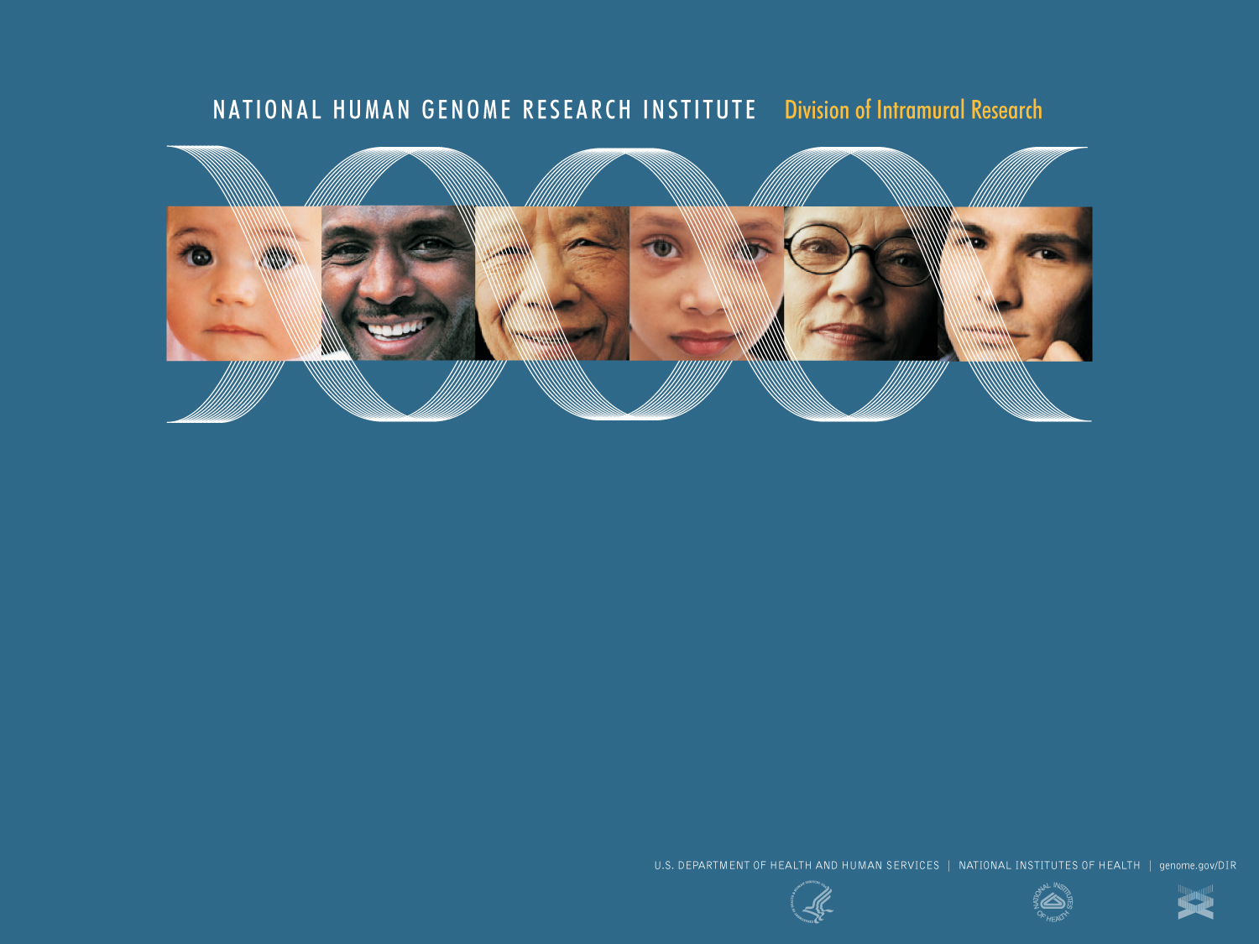

Center for Research on Genomics and Global Health
Introduction to Epidemiology
Adebowale Adeyemo, MD
Deputy Director, Center for Research on Genomics & Global Health
NHGRI/NIH
WT Genome Epidemiology Course, Durban, RSA – June 2015

Slide 3
Introductions
Epidemiology
Bioinformatics
Genetics
Basic principles of measuring disease in populations
Basic genotype data summaries and analyses
population genetics
Public databases and resources for genetics
GWAS QC
Principal components analyses
GWAS association analyses
whole genome sequencing and fine-mapping
GWAS results and interpretation
meta-analysis and power of genetic studies

Slide 4
Outline
Definitions
Key concepts
Applications
Genetic/genomic epidemiology
Resources

Slide 5
What is epidemiology?
The study of the distribution and determinants of health related states and events in populations and the application of this study to control of health problems
Last JM: A Dictionary of Epidemiology
The study of the distribution of a disease or a physiological condition in human populations and of the factors that influence this distribution
Lilienfeld A: in Foundations of Epidemiology

Slide 6
Has origins in the study of epidemics
The branch of medical science which treats of epidemics
Oxford English Dictionary
Epidemiology is the study of "epidemics" and their prevention
Kuller LH: Am J Epid 1991;134:1051

Slide 7
Ebola in West Africa 2014
WHO Ebola Response Team, NEJM 2014

Slide 8
Epidemiology
The study of the distribution and determinants of health related states and events in populations and the application of this study to control of health problems
Last JM: A Dictionary of Epidemiology 4th Ed. 2001

Slide 9
Health related states and events
Epidemics of communicable diseases – original focus
Current scope:
endemic communicable diseases
non-communicable infectious diseases
chronic diseases, injuries, birth defects, maternal-child health, occupational health, and environmental health
health-related behaviors: exercise, seat belt use,
…..

Slide 10
Distribution
Includes frequency and pattern
Frequency: the number of health events (e.g. number of cases of diabetes in a population), also the relationship of that number to the size of the population
Pattern: the occurrence of health-related events by time, place, and person
Time patterns : annual, seasonal, weekly, daily, hourly, weekday versus weekend,
Place patterns: geographic variation, urban/rural differences, and location of work sites or schools
Personal characteristics: demographic factors (age, sex, marital status, and socioeconomic status), as well as behaviors and environmental exposures

Slide 11
Determinants
Causes and other factors that influence the occurrence of disease and other health-related events
Illness does not occur randomly in a population, but happens only when the right accumulation of risk factors or determinants exists in an individual

Slide 12
Two Broad Types of Epidemiology
DESCRIPTIVE EPIDEMIOLOGY
ANALYTIC EPIDEMIOLOGY
Examining the distribution of a disease in a population, and observing the basic features of its distribution in terms of time, place, and person
Typical study design:
community health survey (approximate synonyms - cross-sectional study, descriptive study)
Testing a specific hypothesis about the relationship of a disease to a putative cause, by conducting an epidemiologic study that relates the exposure of interest to the disease of interest
Typical study designs: cohort, case-control

Slide 13
The 5W's of descriptive epidemiology
What = health issue of concern
Who = person
Where = place
When = time
Why/how = causes, risk factors, modes of transmission

Slide 14
Analytic epidemiology
Tests hypotheses about:
Why
How
Comparing groups with different rates of disease occurrence and with differences in demographic characteristics, genetic or immunologic make-up, behaviors, environmental exposures, and other potential risk factors

Slide 15
An epidemiologist
An epidemiologist:
Counts
Divides
Compares
Counting based on case definition i.e. a set of standard criteria for classifying whether a person has a particular disease, syndrome, or other health condition
Divide by the number of cases divided by the size of the population or by the size of the population per unit of time

Slide 16
Measuring frequency
To measure frequency of a disease or event, pay attention to the numerator (cases) and the denominator (population at risk)
Key point in making sense of the numbers

Slide 17
Measures of disease frequency
ratios
proportions
prevalence, incidence
risks, rates, odds
all functions of numerators (cases) and denominators (population at risk or those at risk but disease free)

Slide 18
Measures of disease frequency
ratios: the relative magnitudes of two quantities (usually expressed as a quotient) (A/B)
proportions: a ratio that relates the part (the numerator) to the whole (the denominator) — numerator always part of the denominator (A/A+B)

Slide 19
Prevalence
The prevalence of a disease or condition in a population is defined as:
The total number of cases (existing cases) of the disease in the population at a given time
or
The total number of cases in the population, divided by the number of individuals in the population
It is a proportion and is usually expressed as a percentage

Slide 20
Incidence
The incidence of a disease in a population is defined as:
The total number of NEW cases of the disease in a population at risk of the disease in a defined time period
or
The total number of NEW cases in the population, divided by the total number of individuals at risk of the disease in the population
Again, it is a proportion (RISK) and can be expressed as a percentage

Slide 21
Odds of disease
Provides an alternative way to express a probability (likelihood of an event)
Risk = A / N
Odds = A / (N-A)
Odds = probability / (1 + odds)
Probability = odds / (1 - odds)

Slide 22
Risk and odds
Risk is number of events over number of possible events
Odds is defined as the number of events to the number of non-events
Example: number of cases in exposed group 60, number of cases in unexposed group 10, odds are six to one (60/10) and risk is 86% (60/70)
The odds has properties that make it very useful in epidemiology

Slide 23
Rate
Rate or velocity at which new cases of a particular disease (or outcome of interest) occur in a population at risk for the disease
Calculated as:
Number of individuals developing disease over specified time period
----------------------------------------
Sum of the “disease-free” time experienced by study participants at risk of disease

Slide 24
Measures of association
Measure the strength of association between the exposure and outcome, e.g. How likely are cigarette smokers likely to develop lung cancer?
Could be relative (ratios) or absolute (differences)
Risk ratio
Odds ratio

Slide 25
Measures of association
Measure the strength of association between the exposure and outcome, e.g. How likely are cigarette smokers likely to develop lung cancer?
Could be relative (ratios) or absolute (differences)
Risk ratio
Odds ratio

Slide 26
Measures of association
Measure the strength of association between the exposure and outcome, e.g. How likely are cigarette smokers likely to develop lung cancer?
Could be relative (ratios) or absolute (differences)
Risk ratio
Odds ratio

Slide 27
Measures of association
Measure the strength of association between the exposure and outcome, e.g. How likely are cigarette smokers likely to develop lung cancer?
Could be relative (ratios) or absolute (differences)
Risk ratio
Odds ratio

Slide 28
Risk ratio
 | Case | Control
Exposed | a | b
Unexposed | c | d
Risk ratio = R_{e/} R_{u}
= (120/5000)/(50/5000)
= 2.4
Risk in exposed (R_{e}) = a/(a+b)
Risk in exposed (R_{u})= c/(c+d)
Risk ratio = R_{e/} R_{u}

Slide 29
Odds ratio
 | Case | Control
Exposed | a | b
Unexposed | c | d
Odds of a case being exposed (R_{e}) = a/b
Odds of a control being exposed (R_{u})= c/d
Odds ratio = R_{e/} R_{u} = (a/b)/(c/d) = ad/bc
Odds ratio = R_{e/} R_{u}
= (120/4880)/(50/4950)
= 2.4

Slide 30
Features of odds ratios
Often the only measure calculable for case-control studies
Approximates the risk ratio when the disease is rare
Based on artificially sampled case and control populations, which may not reflect the population rate or risk of disease
If the prevalence of disease is high (high initial risk), the odds ratio can under- or overestimate the risk ratio
Often used in genomic epidemiology because the largest set of studies are case-control designs based on disease definitions and often sampled from patient populations

Slide 31
Study designs
case control
  Compare a group of individuals with disease (“case” group) and a group (“control” group) without disease with respect to the factor of interest (exposure/treatment)
  Retrospective or prospective
cross-sectional
  A sample of a reference population is examined at a given point in time
  A “cohort” is defined and individuals are classified as to disease and exposure levels
cohort
  A sample of a reference population is examined at a given point in time
  A “cohort” is defined and individuals are classified as to exposure levels
  Study participants are followed over time and assessed for the development of disease
experimental

Slide 32
Classical epidemiology and genetic epidemiology
Epidemiology = the study of the distribution and determinants [and control] of health related states and events in human populations
Genetic epidemiology = the discipline that focuses on the familial and genetic determinants of disease and the joint effects of genes and non-genetic determinants
Takes into account the underlying biology and known mechanisms of inheritance

Slide 33
Genome epidemiology
“Human genome epidemiology is the basic science of public health genomics. It is the set of methods for measuring genetic variation within and across populations and for understanding how gene variants interact with other genes and with the environment to cause disease.”
- HuGENet FAQ, ww.cdc.gov/genomics/hugenet/

Slide 34
Goal of genome epidemiology
Discovering genotypes underlying human phenotypes and their distribution in the population
Utilizes ideas and tools from genetics, epidemiology, statistics, clinical science, bioinformatics, genomic science, evolutionary biology….
Depends on technology

Slide 35
Definition of trait or phenotype in GE
Measurable characteristic of an individual that is not itself a genotype
Can be a disease (hypertension, stroke) or just some observable or measurable characteristic (height, blood pressure)
Could be:
  binary or dichotomous (defined by presence or absence of), e.g. diabetes, Parkinson’s disease
  quantitative, e.g. blood pressure, serum cholesterol, C-reactive protein
  time-of-onset/survival

Slide 36
Genome epidemiology depends on
Tools and Technology: high throughput genotyping and sequencing platforms, high performance computers, clusters and fast storage…
Data and Databases: multiple reference databases, genome browsers, central repositories of study data,…
Analytic and Visualization Paradigms

Slide 37
Study approaches in genetic epidemiology
Linkage studies
Candidate gene association studies
Admixture mapping
Genome wide association studies (GWAS)
  Meta-analysis of GWAS
Resequencing and targeted sequencing studies
Copy number/structural variant analysis
WES and WGS
RNA expression: microarrays, RNA-seq
Epigenomic studies, e.g. methylation analysis, chipSeq, etc
…

Slide 38
In this course:
Genetic association studies
Genome wide association studies (GWAS)
Meta-analysis of GWAS
Sequencing studies

Slide 39
Resources
A Short Introduction to Epidemiology (Neal Pearce): http://csm.lshtm.ac.uk/files/2010/09/A-Short-Introduction-to-Epidemiology-Second-Edition.pdf
Principles of Epidemiology in Public Health Practice, Third Edition (CDC Course)
Online: http://www.cdc.gov/ophss/csels/dsepd/ss1978/
PDF: http://www.cdc.gov/ophss/csels/dsepd/SS1978/SS1978.pdf
Coursera, iTunesU,……

